Slide 1
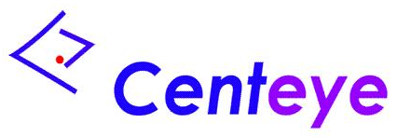
Wide-angle Micro Sensors for Vision on a Tight Budget
Sanjeev J. Koppal
Ioannis Gkioulekas
Todd Zickler
Geoffrey L. Barrows
Harvard University
Harvard University
Harvard University
CentEye, Inc.

Slide 2
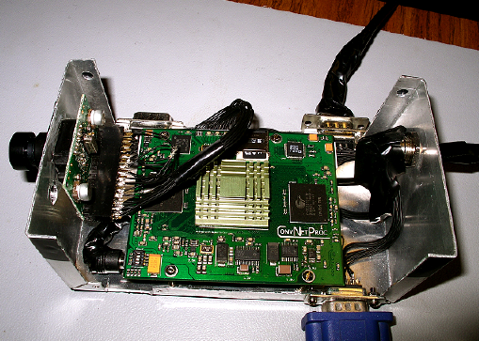
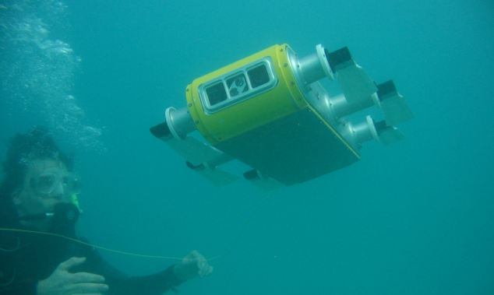
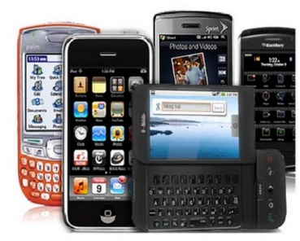
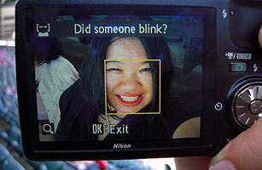
Vision on mobile embedded platforms
Embedded systems
Robots
Smart phones
Cameras
Georgiades et al. 2004, Farabet et al. 2009

Slide 3
Vision on mobile embedded platforms
*
1 hour
Embedded systems
*AAA battery (Alkaline) 1000mAh and 1.5V

Slide 4
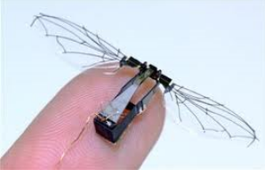
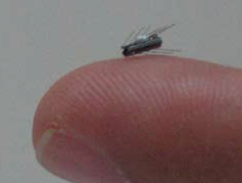
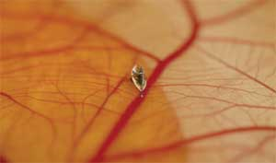
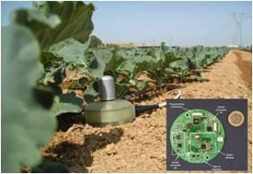
The next wave of micro platforms
Microrobots
Medical devices
Remote sensor nodes
Shoham et al. 2007, Wood 2008, Enikov et al. 2009, Lopez et al. 2009

Slide 5
The next wave of micro platforms
*
1 hour
Embedded systems
*
1 hour
Micro device
*AAA battery (Alkaline) 1000mAh and 1.5V

Slide 6
The next wave of micro platforms
In addition to efficient hardware and software
we need new sources of efficiency

Slide 7
Our idea: Optics as a new efficiency source
Sensor with special optics
The sensor does most of the computation optically

Slide 8
Our micro vision sensor
Single element
Array of optical elements

Slide 9
Optical element design
Lenslet
Refractive
slab
Template
Photodetectors

Slide 10
Three benefits of our design
Optical
filtering
Wide
FOV
Flexible design space

Slide 11
Traditional filtering
Image
Filter bank
Combine
filter responses
for vision tasks

Slide 12
Traditional filtering is expensive
Image
Expensive
Template
Filter response

Slide 13
Optical filtering
Image
Scene
Expensive
“Free”
Template
Filter response
Image sensor
Goodman 1968, Yu and Jutumulia 1998, Nayar et al. 2004, Zomet and Nayar 2006

Slide 14
Three benefits of our design
Optical
filtering
Wide
FOV
Flexible design space

Slide 15
Micro devices need a wide FOV

Slide 16
Narrow FOV increases energy use

Slide 17
Narrow FOV increases energy use

Slide 18
Narrow FOV increases energy use

Slide 19
Narrow FOV increases energy use

Slide 20
Wide FOV
Wide FOV reduces power consumption

Slide 21
Snell’s window
Grazing ray
Refractive
slab

Slide 22
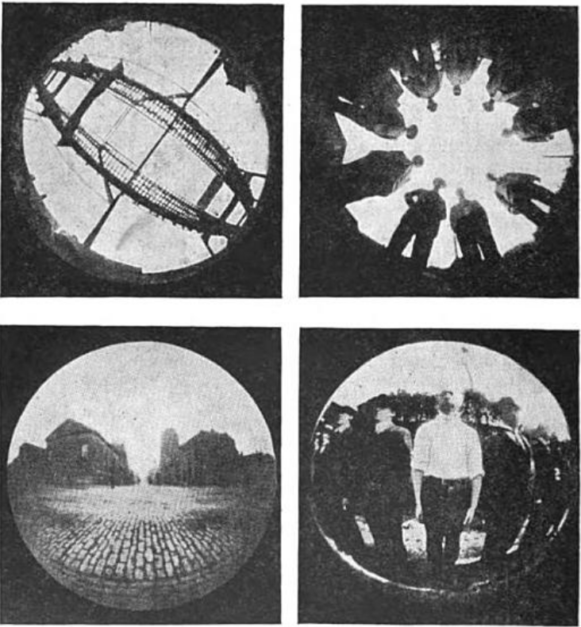
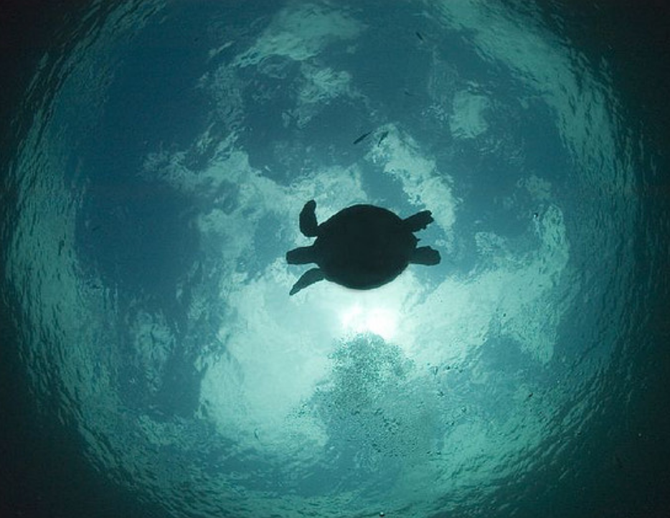
Snell’s window in imaging
“Water” camera
Underwater photography
Wood 1911, Flickr

Slide 23
Three benefits of our design
Optical
filtering
Wide
FOV
Flexible design space

Slide 24
Design space

Slide 25
Design space
d
Template width
u
n
R
Template height
n
1
2
n
Medium
refractive index
d
u
1
n
Lenslet
refractive index
Photodetector array
2
R
Lenslet
radius of curvature

Slide 26
Lensless case in air
d
d
u
u
Photodetector array
Mass is negligible

Slide 27
Lensless case in air
Template
d
d
u
u
Photodetector array

Slide 28
Angular support
Photodetector array

Slide 29
Foreshortening distortion in angular support
Photodetector array

Slide 30
Plot Angular support vs. Viewing direction
Angular
support
Viewing direction

Slide 31
Tolerance
Angular
support
User-defined
desired support
User-defined
tolerance
Viewing direction

Slide 32
Effective field of view (eFOV)
Angular
support
Near-constant
angular support
Viewing direction
Our goal: Maximize eFOV in the least mass and volume

Slide 33
Maximizing eFOV for the lensless case
Angular
support
d
d
u
u
Viewing direction
Photodetector array

Slide 34
Maximizing eFOV for the lensless case
Angular
support
d
u
d
Photodetector array
Viewing direction

Slide 35
Maximizing eFOV for the lensless case
Angular
support
Near-constant
angular support
Viewing direction

Slide 36
Maximizing eFOV for the lensless case
Given user defined parameters ( , )
Guess a large template width d
Optimize template height u to find best eFOV
Scale the design to reduce volume:
d
Printing resolution or Diffraction limit
u
Minimum
photodetector width

Slide 37
Angular support for refractive slab
Angular
support
Viewing direction
Photodetector array

Slide 38
Refractive distortion in angular support
Near-constant
angular support
Angular
support
Viewing direction

Slide 39
Design with lenslets
d
Template width
u
n
R
Template height
n
1
2
n
Medium
refractive index
d
u
1
n
Lenslet
refractive index
2
R
Lenslet
radius of curvature
Lenslets increase flexibility of the design

Slide 40
Two designs with identical eFOV
d
d
u
u
u’< u
High volume
High mass

Slide 41
Rich design space for trade-offs
d
Template width
u
n
R
Template height
n
1
2
n
Medium
refractive index
d
u
1
n
Lenslet
refractive index
2
R
Lenslet
radius of curvature

Slide 42
Equations for eFOV
Angular
support
Lensless
a
b
v
n
1
Lenslet
d
R,
u
n
2
Refractive slab
x
Use mass/volume equations for cuboid and spherical cap

Slide 43
Lookup table for ( )
eFOV
“Max” projection
Volume
Mass

Slide 44
Max eFOV visualization of lookup table
Maximum eFOV (deg)
5
145
1000
mm
3
n
R
n
145
1
2
Volume
d
u
0
0
Mass
1000
mg

Slide 46
Milli-scale prototypes and applications

Slide 47
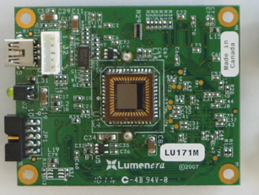
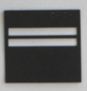
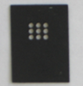
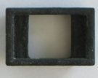
Prototype
Array of elements
~5mm
Camera and holders
Baffles

Slide 48
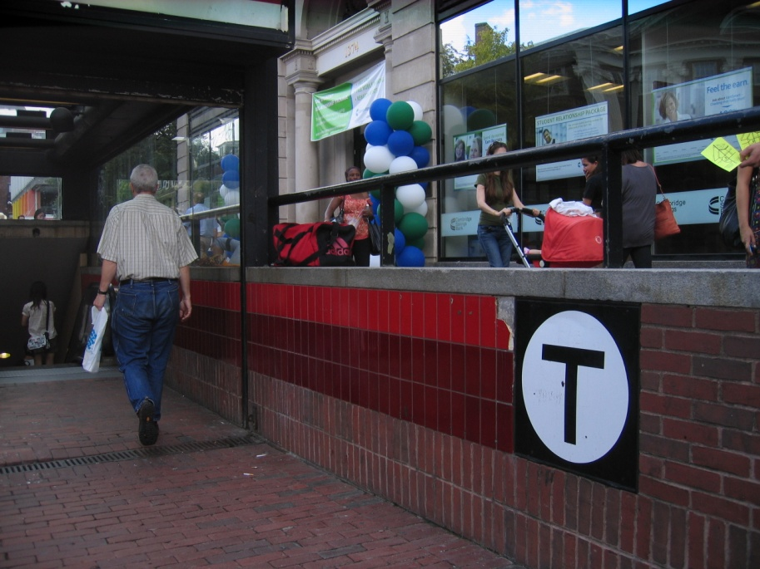
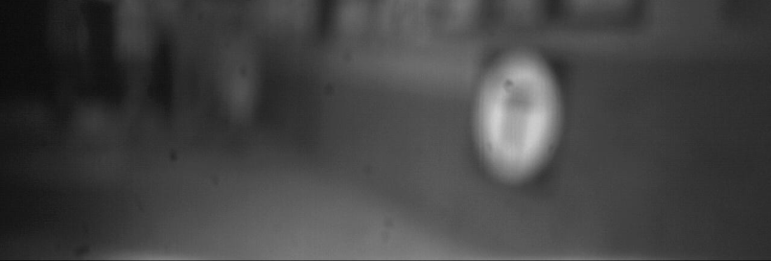
Template tracking
Templates
Scene
Sensor measurements

Slide 49
Outdoor scene

Slide 50
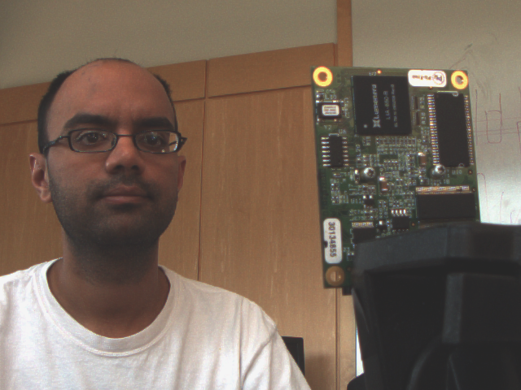
Lensless face detection
Scene
Baffles

Slide 51
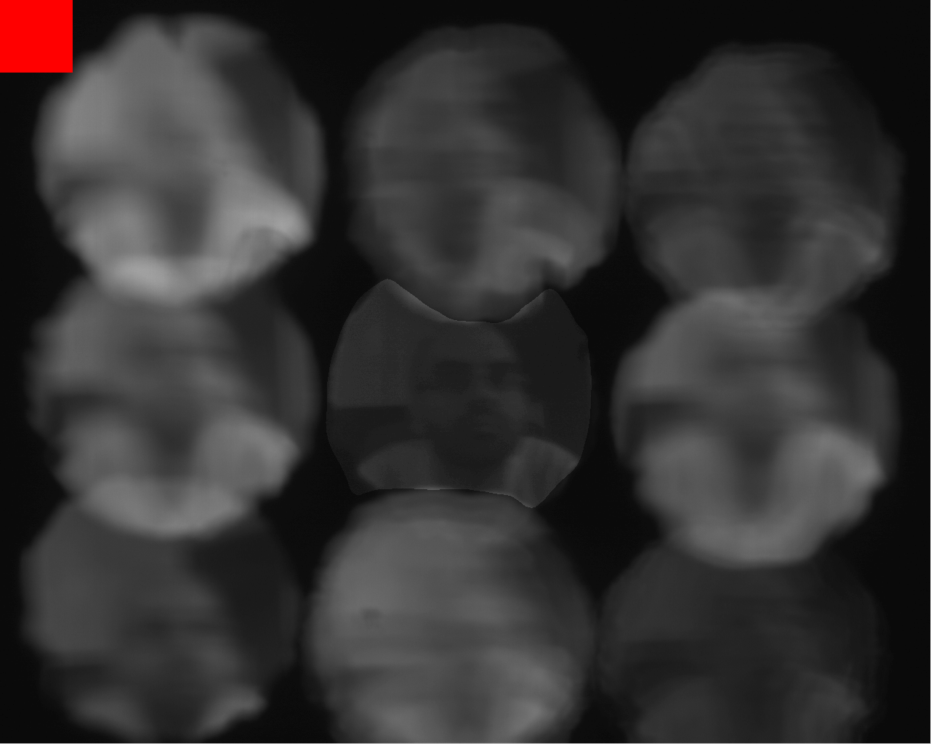
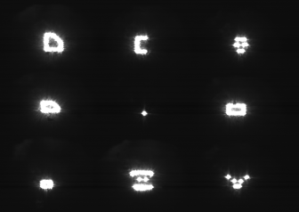
Lensless face detection
Pinhole for validation
Face detected
Templates
Scene
Sensor measurements
Center of each subimage gives 8 numbers
Linear classifier:
Kumar et al. 2009

Slide 52
Face detection

Slide 53
Templates for micro sensors
Limited number of templates
Only positive values
No normalization
Noise in the printing process
Learn with tolerance
Learn spatio-spectral templates
Printed templates

Slide 54
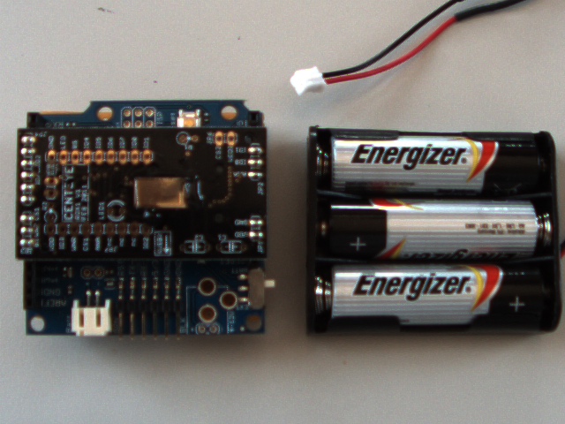
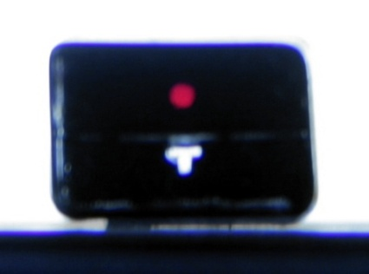
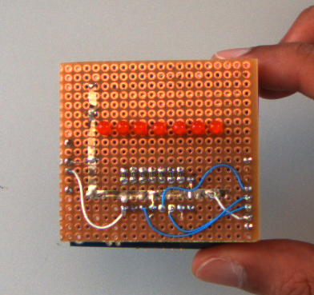
Tracking with spectral templates
Red
filter
Imager shield
Templates embedded
in acrylic
Arduino board
LED array
Reverse side
eFOV divided into regions

Slide 55
Tracking a simple target

Slide 56
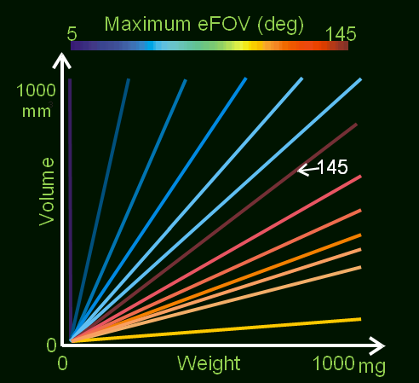
Recap
Optics for vision
on micro devices
Wide FOV filtering
due to refractive slab
Provided design tools
Milli-scale prototypes

Slide 57
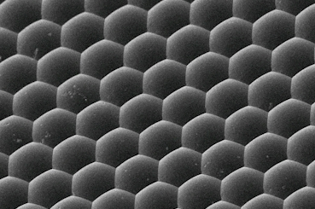
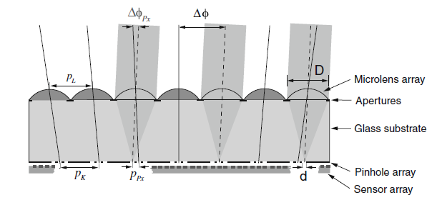
Future work: fabricating micro vision sensors
Nalux 2011, Bruckner et al. 2009

Slide 58
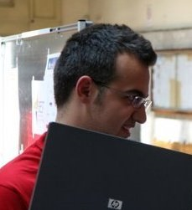
Thanks
Todd
Ioannis
Geof
Come by our demo tomorrow!

Slide 62
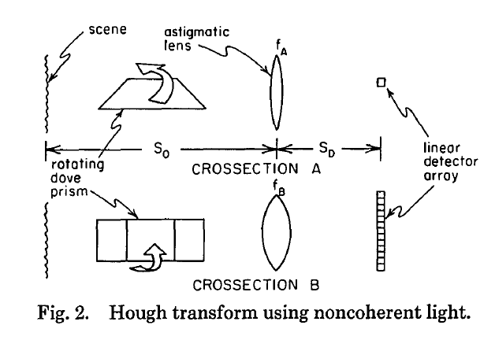
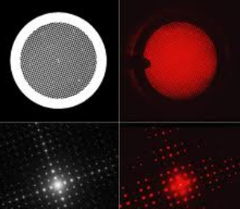
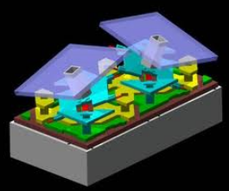
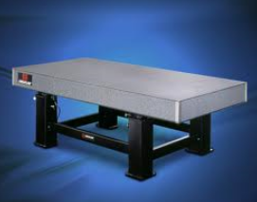
Speculative directions
Rotating prisms!
Exploiting diffraction
Programmable templates
Traditional optical computing
Goodman 1968, Dudley et al. 2003, Nayar et al. 2006, Steier and Shori 1986

Slide 63
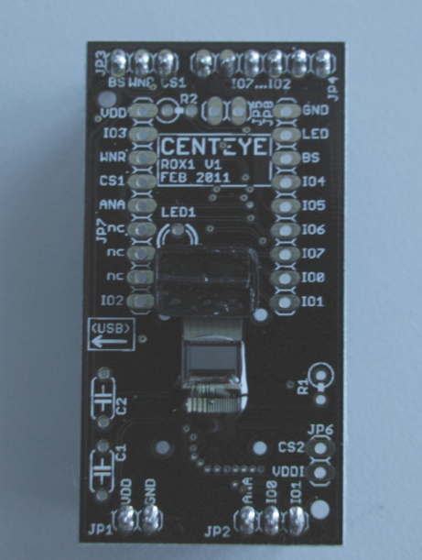
Our current optics
with 2 templates
Our future optics size:
1/4th the size
with 6 templates
http://robobees.seas.harvard.edu/
Fully autonomous robot insect in 3-5 years

Slide 64
Packing/Mosaicing optics to maximize eFOV
Angular
support
‘
‘
“
“
Viewing direction
“Optical” knapsack problem

Slide 65
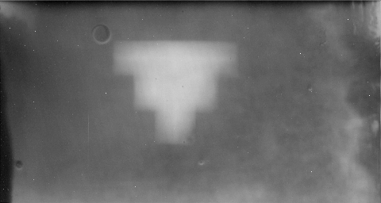
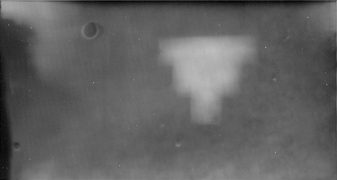
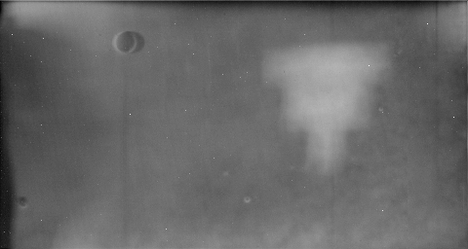
Validation of refractive slab effect
Image
Template
In software
T
T
T
0 deg
45 deg
In optics
80 deg

Slide 66
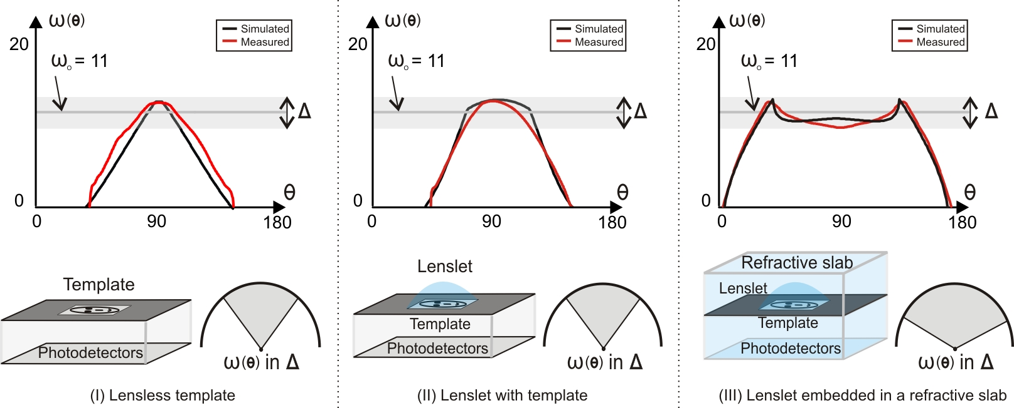
Validation

Slide 67
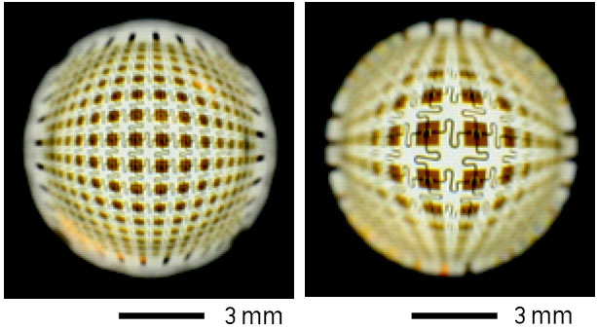
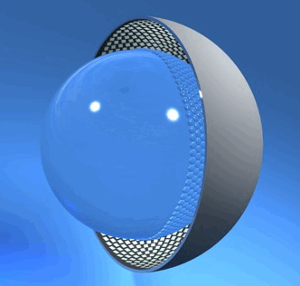
Curved sensors
Ko et al. 2008, Cossairt et al. 2011, Krishnan and Nayar 2009

Slide 68
Curved sensors have a mass/volume tradeoff
Piecewise continuous
templates
n
n
R
1
2
d
u
Our sensor:
compact but heavy
Curved sensor
Light but large

Slide 69
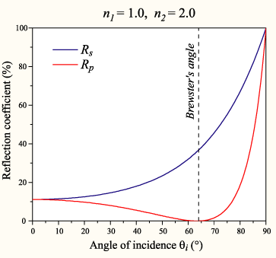
SNR design issues
d
Lenslets allow larger template for same eFOV
d’>d
“Fresnel Vignetting” in refractive slab
Optically pre-processed images
may not need high SNR

Slide 70
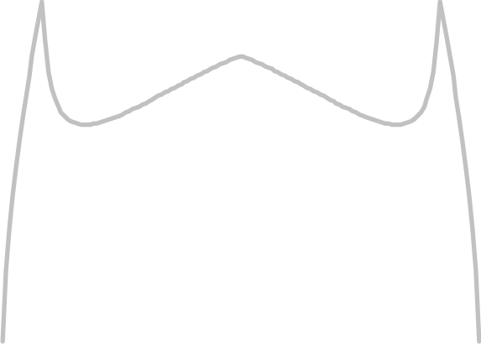
Discontinuity in lookup table
Maximum eFOV (deg)
5
145
1000
mm
3
Volume
0
0
Mass
1000
mg

Slide 71
Optics win if task is specific
Regular
optics
Our
Optics
Regular
optics
Our
Optics
General
processor
Accelerator
Accelerator
Accelerator
Regular
optics
Regular
optics
Our
Optics (extra)
Accelerator
Further analysis required
General
processor
General
processor
Accelerator

Slide 72
3D optical designs
Template (top view)
d
d
u
u
Photodetector array
2d Angular
support
Pixel
Viewing direction

Slide 73
Lenslet in air is inverted

Slide 74
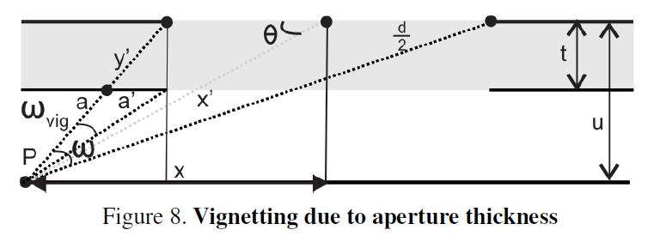
Vignetting due to aperture

Slide 75
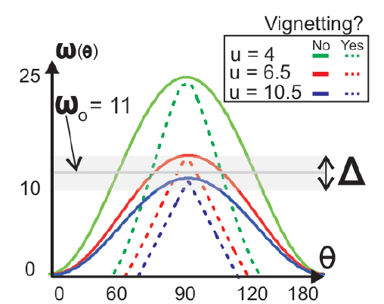
Vignetting due to aperture

Slide 76
Refractive vignetting
Angular
support
Viewing direction
Photodetector array

Slide 77
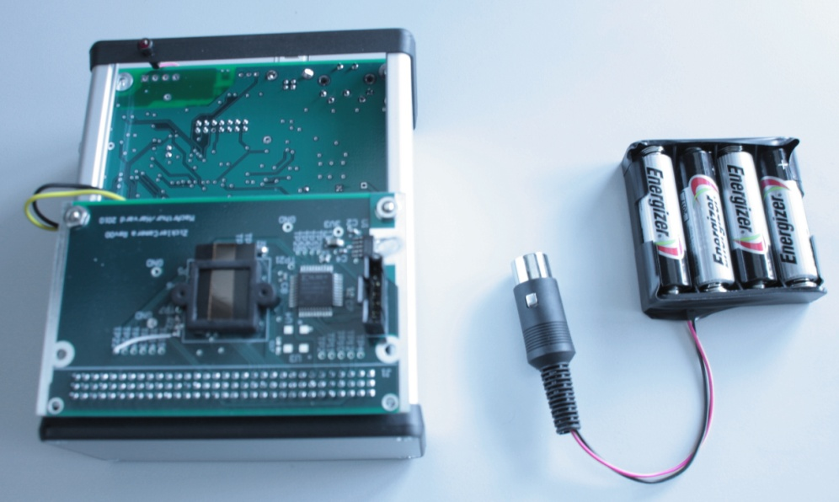
Face detection with spectral templates
Optics with skin reflectance filters
LED
Embedded system with optics
Nearest neighbor matching
Angelopoulou 1999, Osorio and Anderson 2007

Slide 78
More face detection results

Slide 79
Longer face detection

Slide 80
Design parameter ranges are limited
d
Template width
Sensors have reasonable limits
0 – 10mm
u
Template height
n
Medium
refractive index
1
These range from 1 – 2
(most materials)
n
Lenslet
refractive index
2
Lenses with reasonable focal lengths
< 5 mm
R
Lenslet
radius of curvature

Slide 81
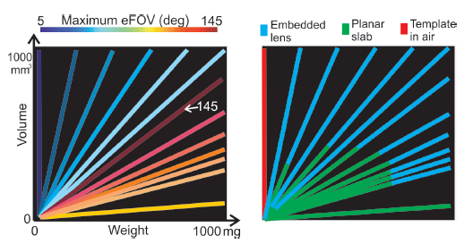
Lookup table with masks

Slide 82
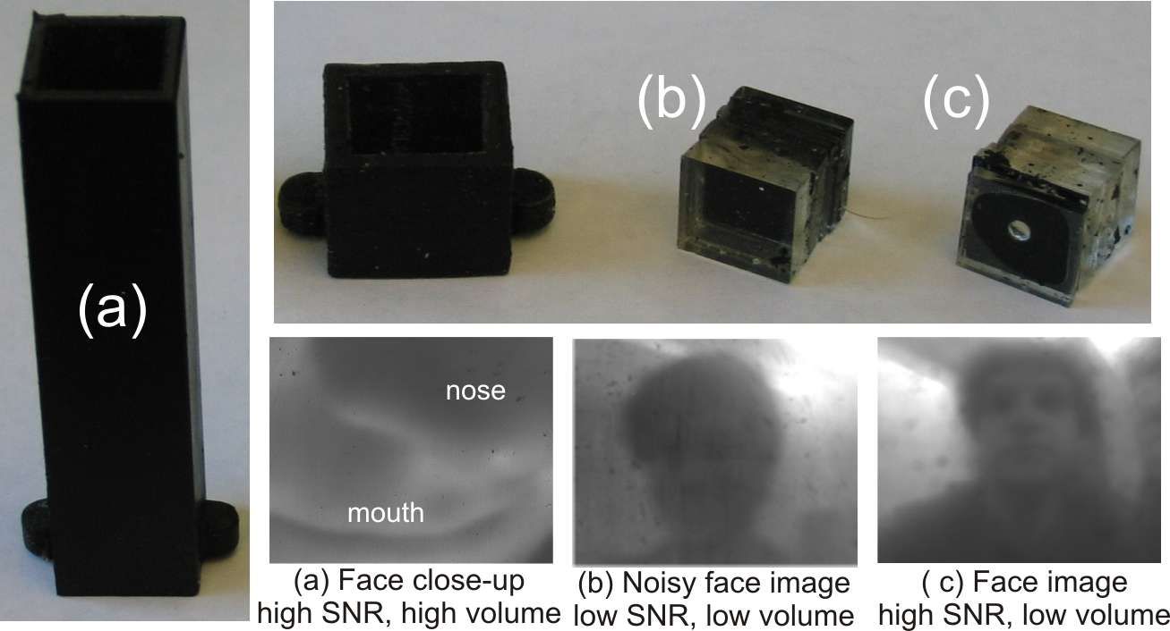
SNR comparisons

Slide 83
Optimal designs for lensless Snell’s
n’’
>
n’
1
1
n’
n’’
1
1
Increasing refractive index increases FOV
But it increases mass

Slide 84
Lensless configuration
~0.1mm
Template
Simple planar scene
Differently
blurred images

Slide 85
Edge results
Input
Output by subtracting images

Slide 86
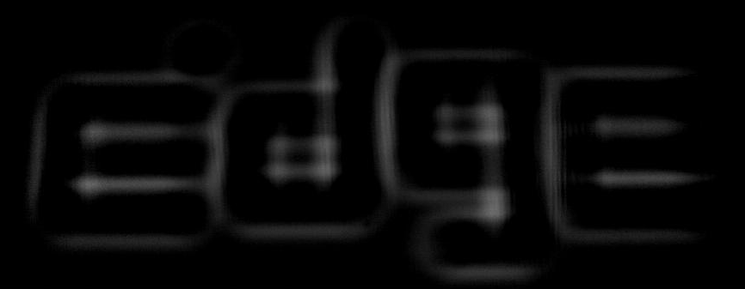
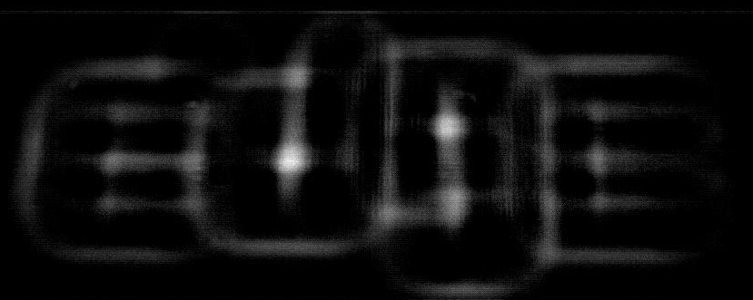
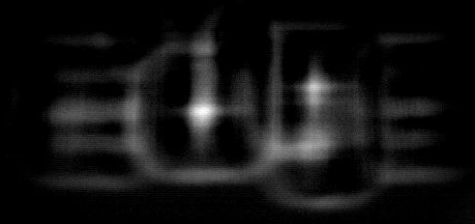
Our theory is useful
The optimal template height u
Too close
Too far away

Slide 87
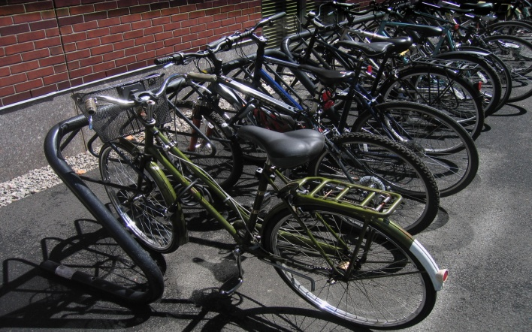
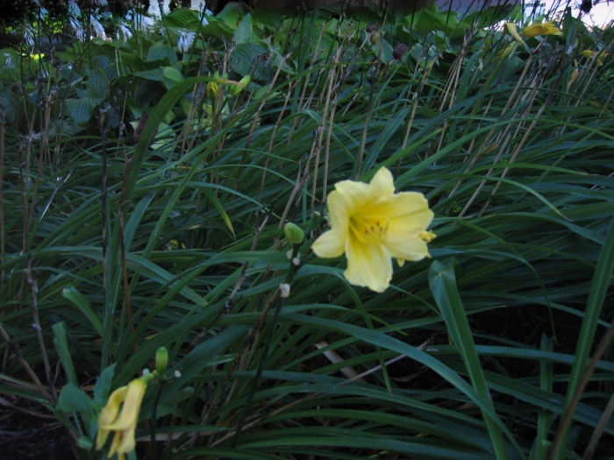
Outdoor edge results (90 eFOV)
Scene
Input
Output

Slide 88
Wide FOV edge detection (120 eFOV)
Optical glue
Snell’s
window
Scene

Slide 89
Snell’s window
Without
Snell’s window
With
Snell’s window
Scene

